Slide 1
Data Analysis and Forecasting in the Non-Profit Sector
MATH 499 Capstone
Noah Mancione

Slide 2

Internship Overview
Worked for a local non-profit
Built projection models and forecasted future donors and revenue

Slide 3
Fictional Organization

Slide 4
Humanitarian non-profit founded in 2010
Provides clean water, teacher training, community health resources across the globe
Funded mostly by mid-level donors

Slide 5

How Non-profits Work
Three key differences from for-profits
Goal is different – impact vs. sales
Revenue Source is less predictable – generosity vs. product
Human behavior-driven: relational vs need

Slide 6
Generating Synthetic Data
Added to my python script
Seasonality
Retention/churn rate
External Shocks

Slide 7
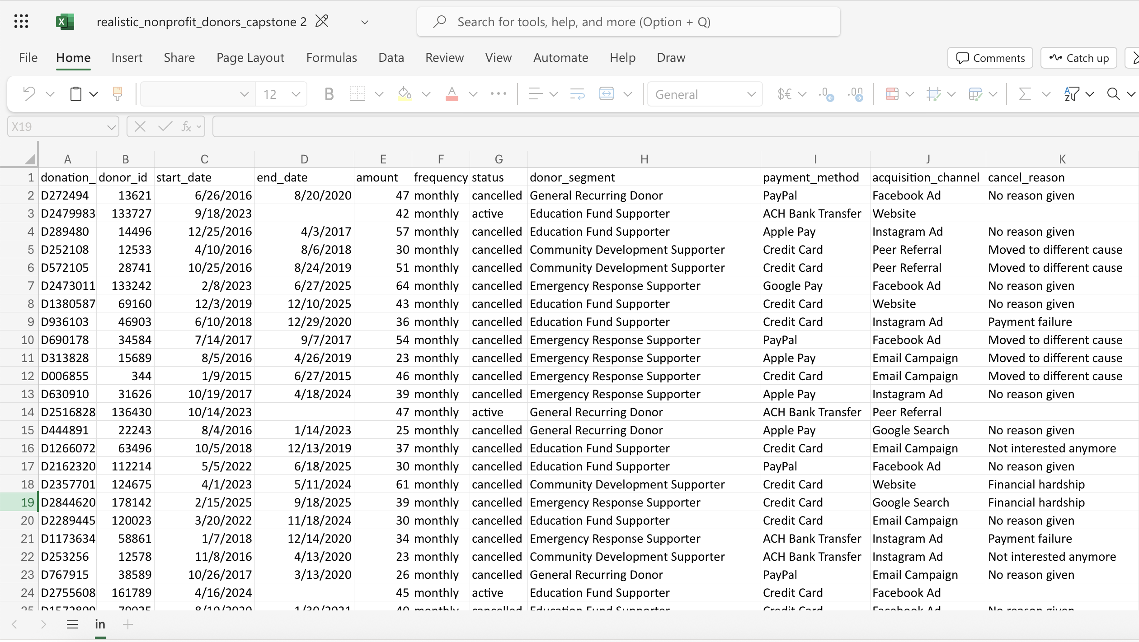

Slide 8

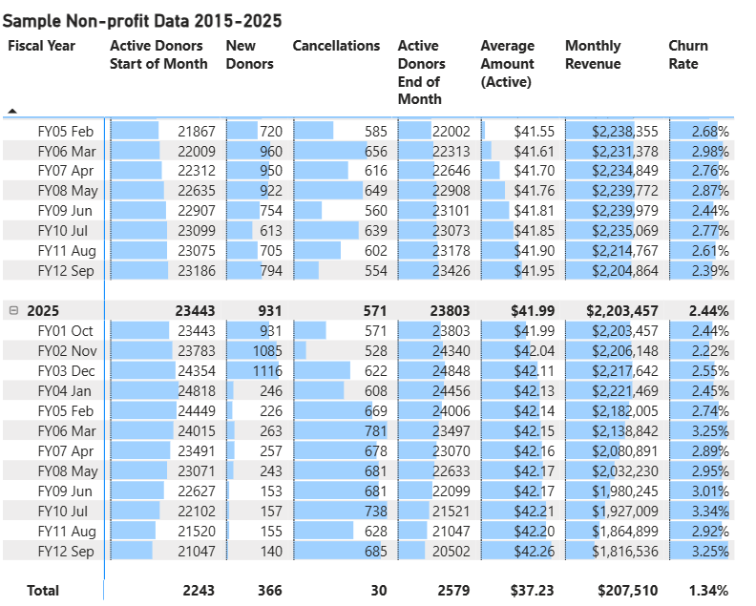
Data cleaning & Microsoft PowerBI
Messy, unorganized
150k rows of data
Simple and Interpretable

Slide 9
Data Cleaning
Clean
Interpretable
Shows key trends

Slide 10
Mathematical Modeling
ARIMA Model
Autoregressive
(p)
Integrated (d)
Moving Average (q)

Slide 11
Mathematical Modeling
SARIMAX Model
Autoregressive
(p)
Integrated (d)
Moving Average (q)
Exogenous Variable
Seasonal

Slide 12
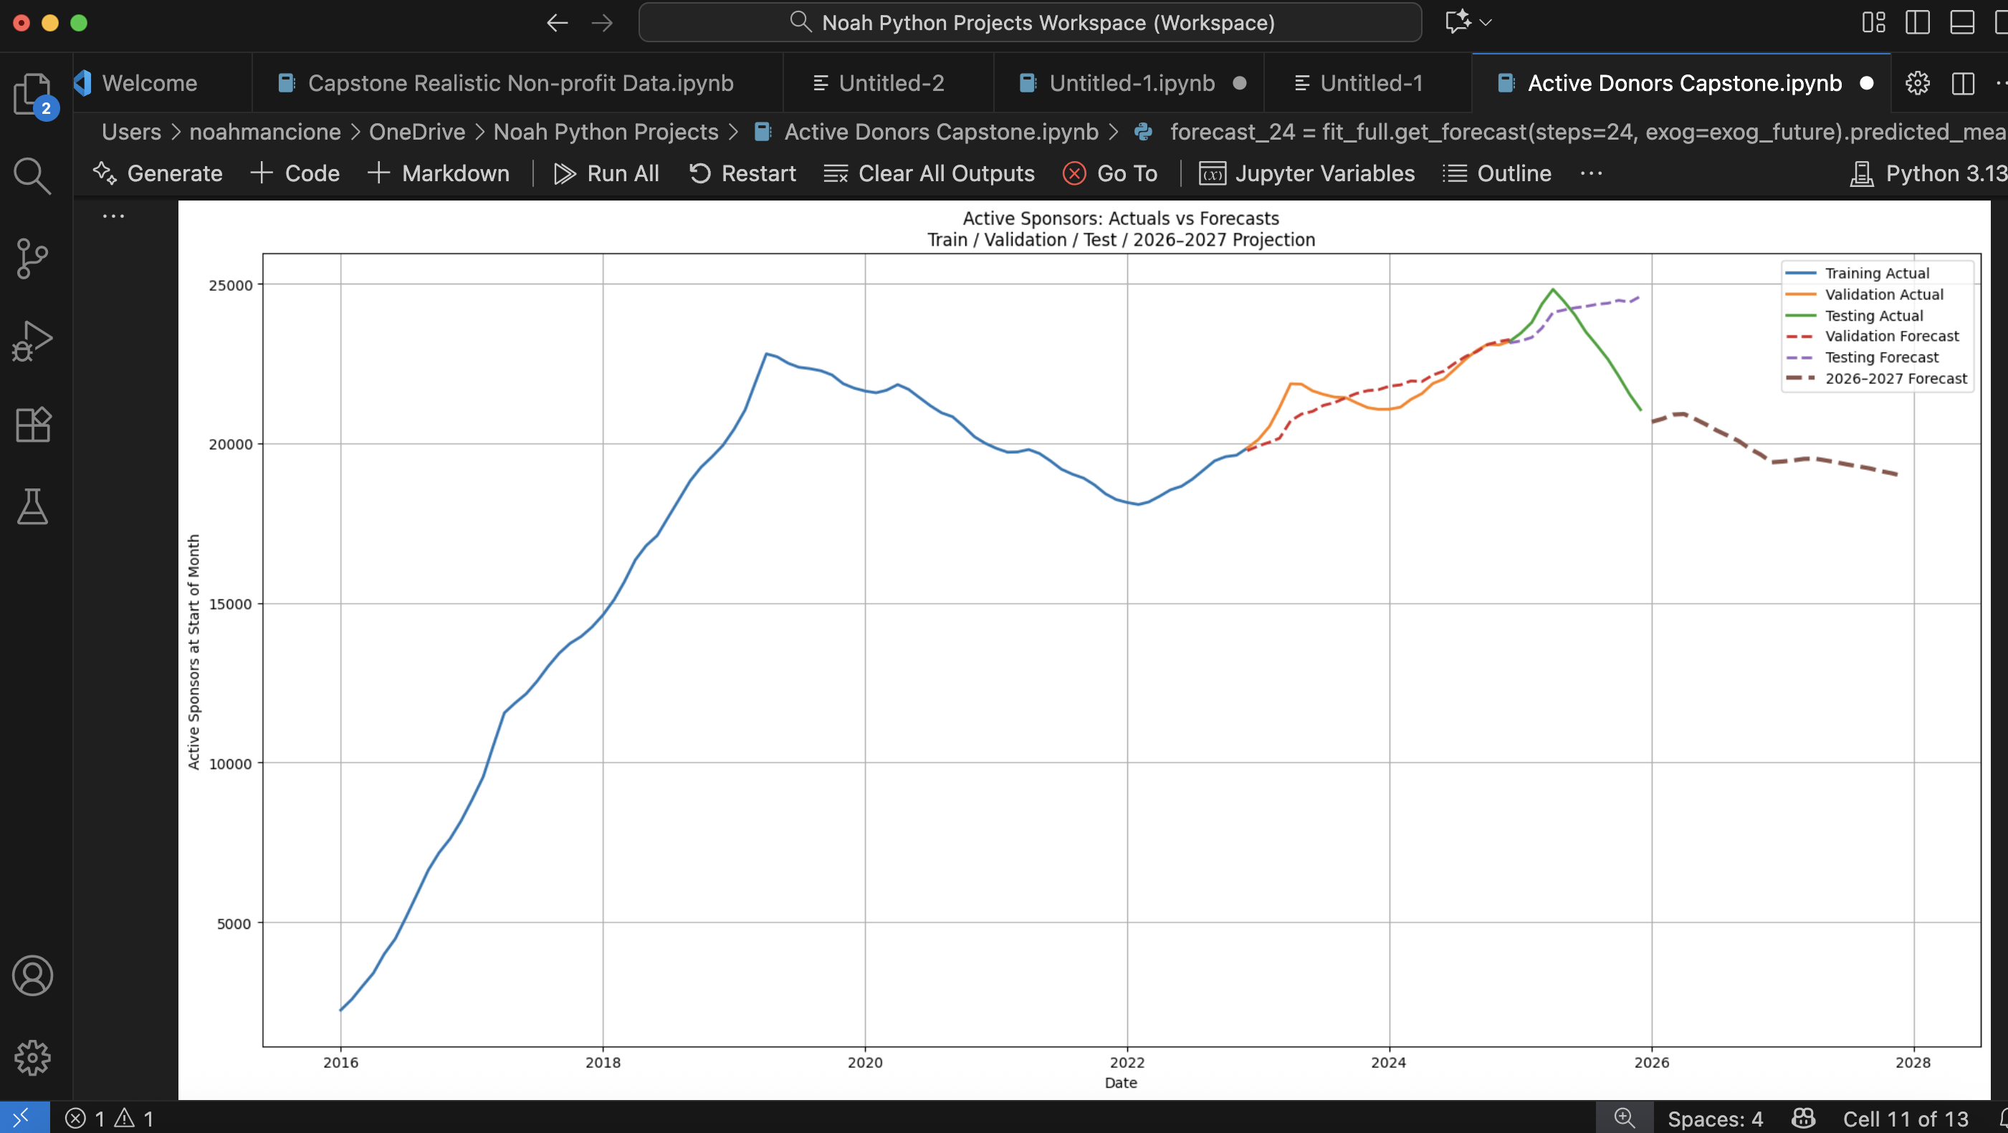

Slide 14
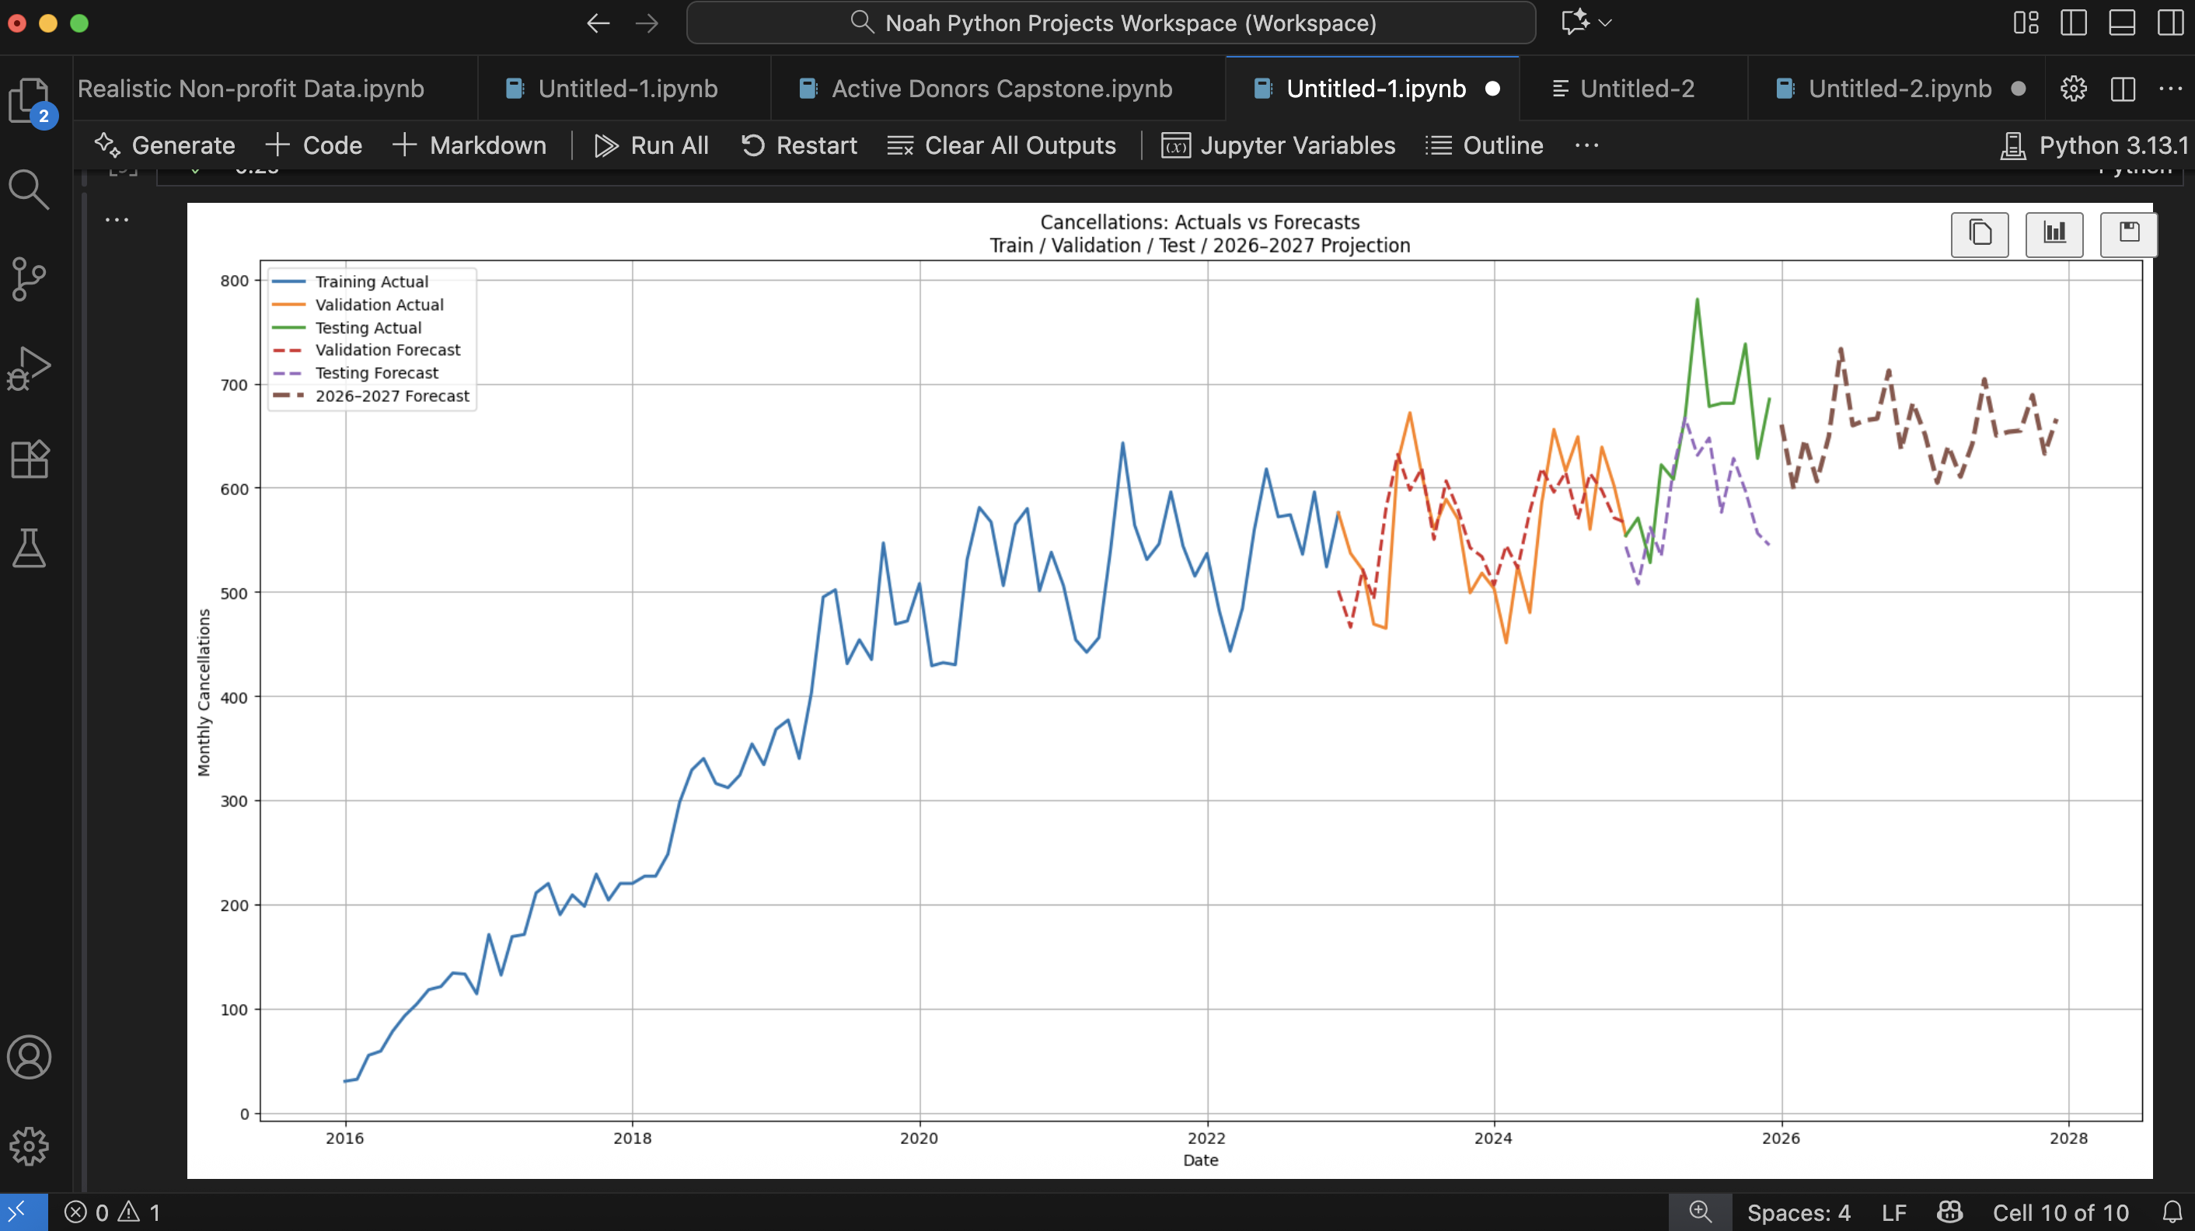

Slide 15
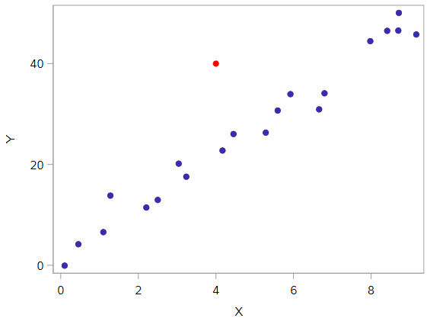


Linear Regression

Slide 16

Linear Regression

Slide 17
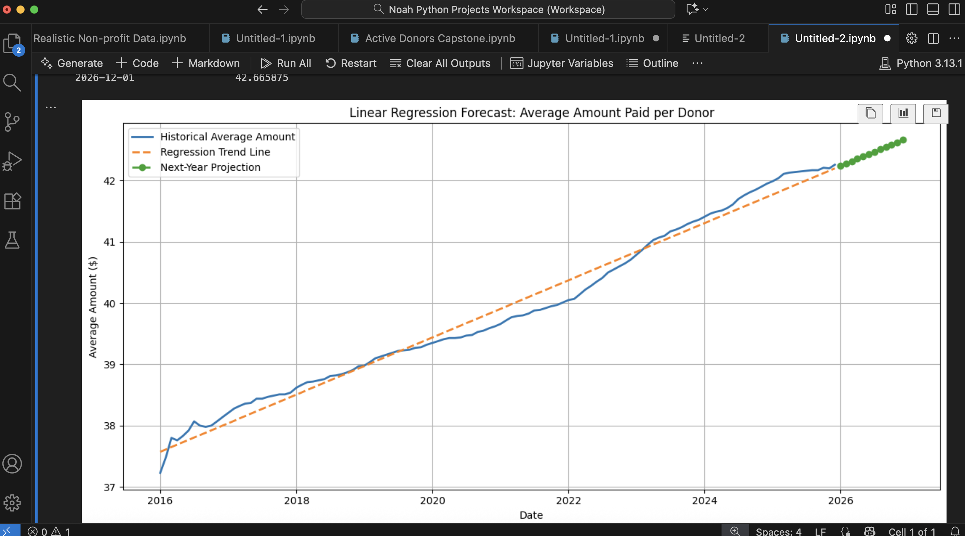

Slide 18
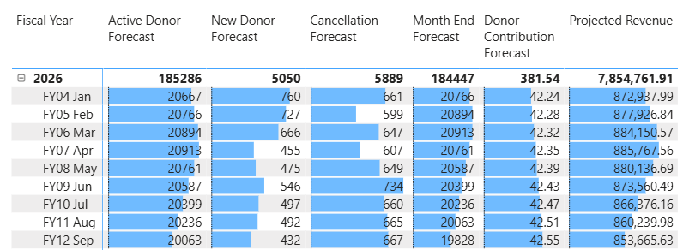
FY 2026 Projection model

